Slide 1
EXCEL-BASED CAPSTONE PROJECT
CloudFlow SaaS
Customer Intelligence
Analysis
Customer Retention, Revenue, Acquisition & Lifetime Value
Nitin Prasad
ANALYSIS PERIOD / 2023–2025

Slide 2
Business Context
CloudFlow is an India-based SaaS business delivering subscription services to businesses. Management needs a sharper view of customer behavior across the lifecycle.
01
02
03
CUSTOMERS
RETENTION
VALUE
Who are our customers?
Who stays and who churns?
Which customers generate long-term value?
CLOUDFLOW / CUSTOMER INTELLIGENCE
02

Slide 3
Business Problem & Objectives
CloudFlow needs a clear view of which customers stay, which customers leave, what drives churn, and which customers create long-term value.
01
02
03
CUSTOMER & CHURN
REVENUE & LTV
ACQUISITION & COHORT
Analyze retention, churn, customer health, and churn reasons
Measure recurring revenue, tenure, and customer lifetime value
Evaluate acquisition channels and customer cohort performance
CLOUDFLOW / CUSTOMER INTELLIGENCE
03

Slide 4
Dataset Overview
One row represents one customer subscription.
10,000
18
2023–2025
India
No Intentional Nulls
CUSTOMER RECORDS
RAW BUSINESS COLUMNS
ANALYSIS PERIOD
CUSTOMER MARKET
DATASET QUALITY
CUSTOMER PROFILE
SUBSCRIPTION
REVENUE
Customer ID, Company, Industry, State, Employee Count
Plan, Start Date, Renewal Date, Validity Date
MRR, Discount
CUSTOMER HEALTH
CHURN & ENGAGEMENT
Support Tickets, Product Usage, Satisfaction
Churn Reason, Last Login Date
Synthetic dataset created for educational and portfolio purposes.

Slide 5
Data Preparation & Analytical Layer
1 RAW DATA
2 DATA VALIDATION
3 CALCULATED METRICS
4 PIVOT ANALYSIS
Customer Status
Company Size
Cohort Month
Tenure Months
Net MRR
Annualized Revenue
Customer Lifetime Revenue
Churn Flag
Renewal Status
Login Recency
Calculated metrics were created in Excel rather than embedded directly in the raw dataset.
CLOUDFLOW / CUSTOMER INTELLIGENCE
05

Slide 6
Analytical Framework
01
02
03
CUSTOMER & CHURN ANALYSIS
REVENUE & LTV ANALYSIS
ACQUISITION & COHORT ANALYSIS
Active vs Churned Customers
Churn Rate · Churn Reasons
Satisfaction · Product Usage
Cohort Churn
Net MRR · Annualized Revenue
Customer Lifetime Revenue
Customer Tenure · Plan Performance
Industry Value
Acquisition Channels · Channel Churn
Channel LTV · Acquisition Trend
Cohort Churn · Cohort Value
CLOUDFLOW / CUSTOMER INTELLIGENCE
06

Slide 7
Customer & Churn Analysis
Understanding who churns, why they churn, and which customer characteristics are associated with retention.
01 Compare active and churned customers across subscription plans.
18.99%
02 Identify the major reasons customers leave.
OVERALL CHURN RATE
03 Examine churn differences across company-size segments.
04 Explore how satisfaction and product usage relate to retention.
8,101
1,899
05 Track observed churn across customer cohorts.
ACTIVE CUSTOMERS
CHURNED CUSTOMERS
CLOUDFLOW / CUSTOMER INTELLIGENCE
07

Slide 8
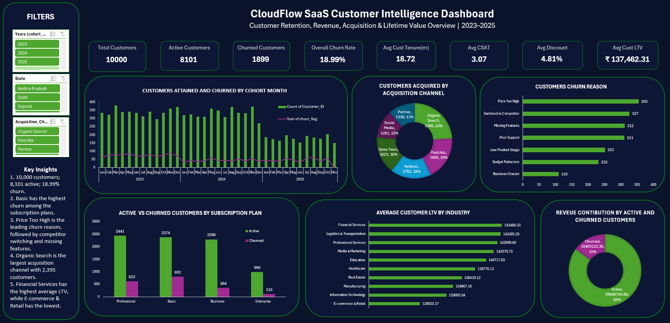
SaaS Customer Intelligence Dashboard
Interactive Excel dashboard consolidating customer, churn, revenue, acquisition, and cohort insights.
CLOUDFLOW / CUSTOMER INTELLIGENCE
08

Slide 9
Revenue & Customer Lifetime Value
REVENUE SNAPSHOT
₹69.85 lakh Current Net MRR
₹8.38 crore Annualized Revenue
85% MRR from Active Customers
≈ ₹1.37 lakh
AVERAGE CUSTOMER
LIFETIME REVENUE
CUSTOMER VALUE SNAPSHOT
₹1.37 lakh Average Customer Lifetime Revenue
18.72 months Average Customer Tenure
Financial Services Highest Average LTV Industry
E-commerce & Retail Lowest Average LTV Industry
Longer customer tenure generally increases observed lifetime revenue.
CLOUDFLOW / CUSTOMER INTELLIGENCE
09

Slide 10
Acquisition & Cohort Analysis
ACQUISITION SNAPSHOT
Organic Search is the largest acquisition channel, accounting for 24% of customers.
2,395 | Organic Search
1,895 | Paid Ads
1,752 | Referral
1,621 | Sales Team
1,201 | Social Media
1,136 | Partner
Cohort performance varies across acquisition periods, while newer cohorts have had less time to mature.
COHORT & RETENTION TAKEAWAYS
18.99% Overall Customer Churn Rate
2023–2025 Customer Acquisition Period
6 Acquisition Channels
CLOUDFLOW / CUSTOMER INTELLIGENCE
10

Slide 11
Key Business Insights
01
10,000 customers were analyzed, with 8,101 active and 1,899 churned customers.
05
Organic Search is the largest customer acquisition channel with 2,395 customers.
02
Overall customer churn rate is 18.99%.
06
Average customer lifetime revenue is approximately ₹1.37 lakh.
03
Basic has the highest number of churned customers among the subscription plans.
07
Financial Services has the highest average customer lifetime revenue among the analyzed industries.
04
Price Too High is the leading recorded churn reason.
CLOUDFLOW / CUSTOMER INTELLIGENCE
11

Slide 12
Conclusion
DATA
CALCULATIONS
PIVOT ANALYSIS
DASHBOARD
BUSINESS INSIGHTS
Data Preparation
Calculated Columns
PivotTables & PivotCharts
KPI Analysis
Interactive Dashboard Design
Thank You
CLOUDFLOW / CUSTOMER INTELLIGENCE
12

